Slide 1
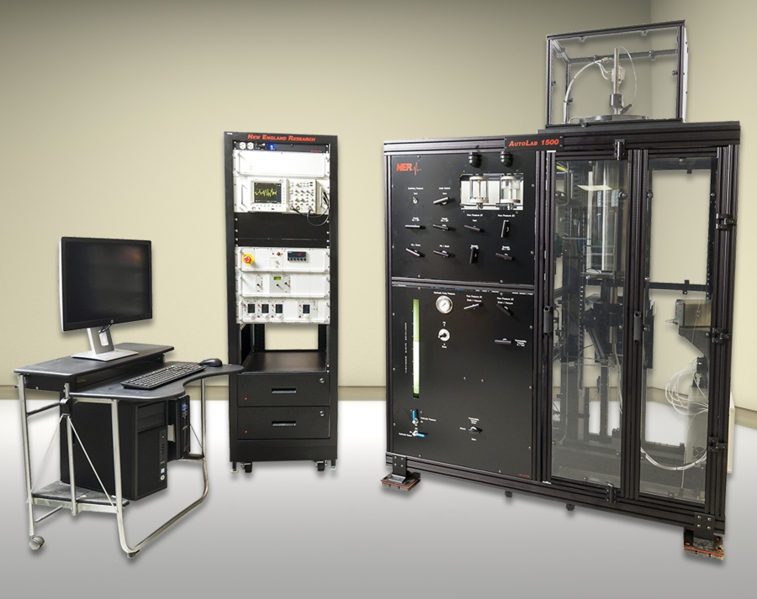
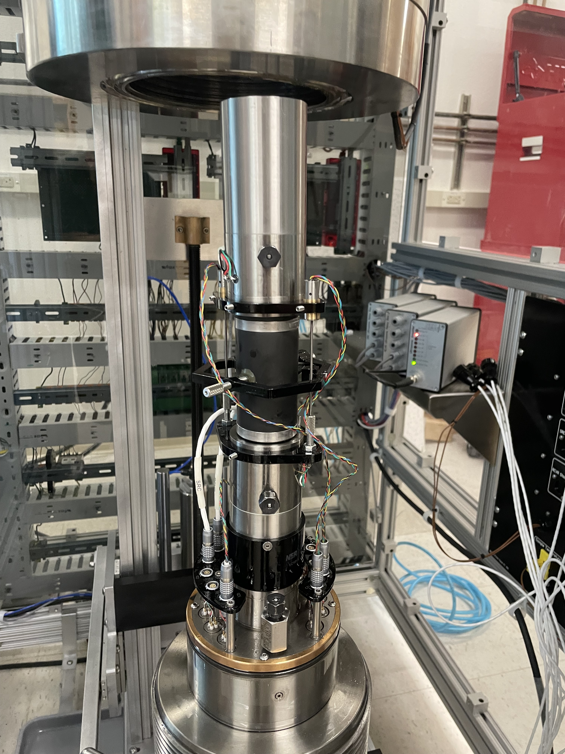
High Temperature AutoLab 2000

Slide 2
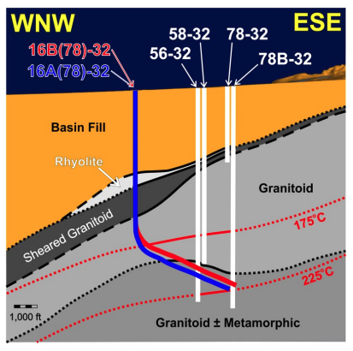
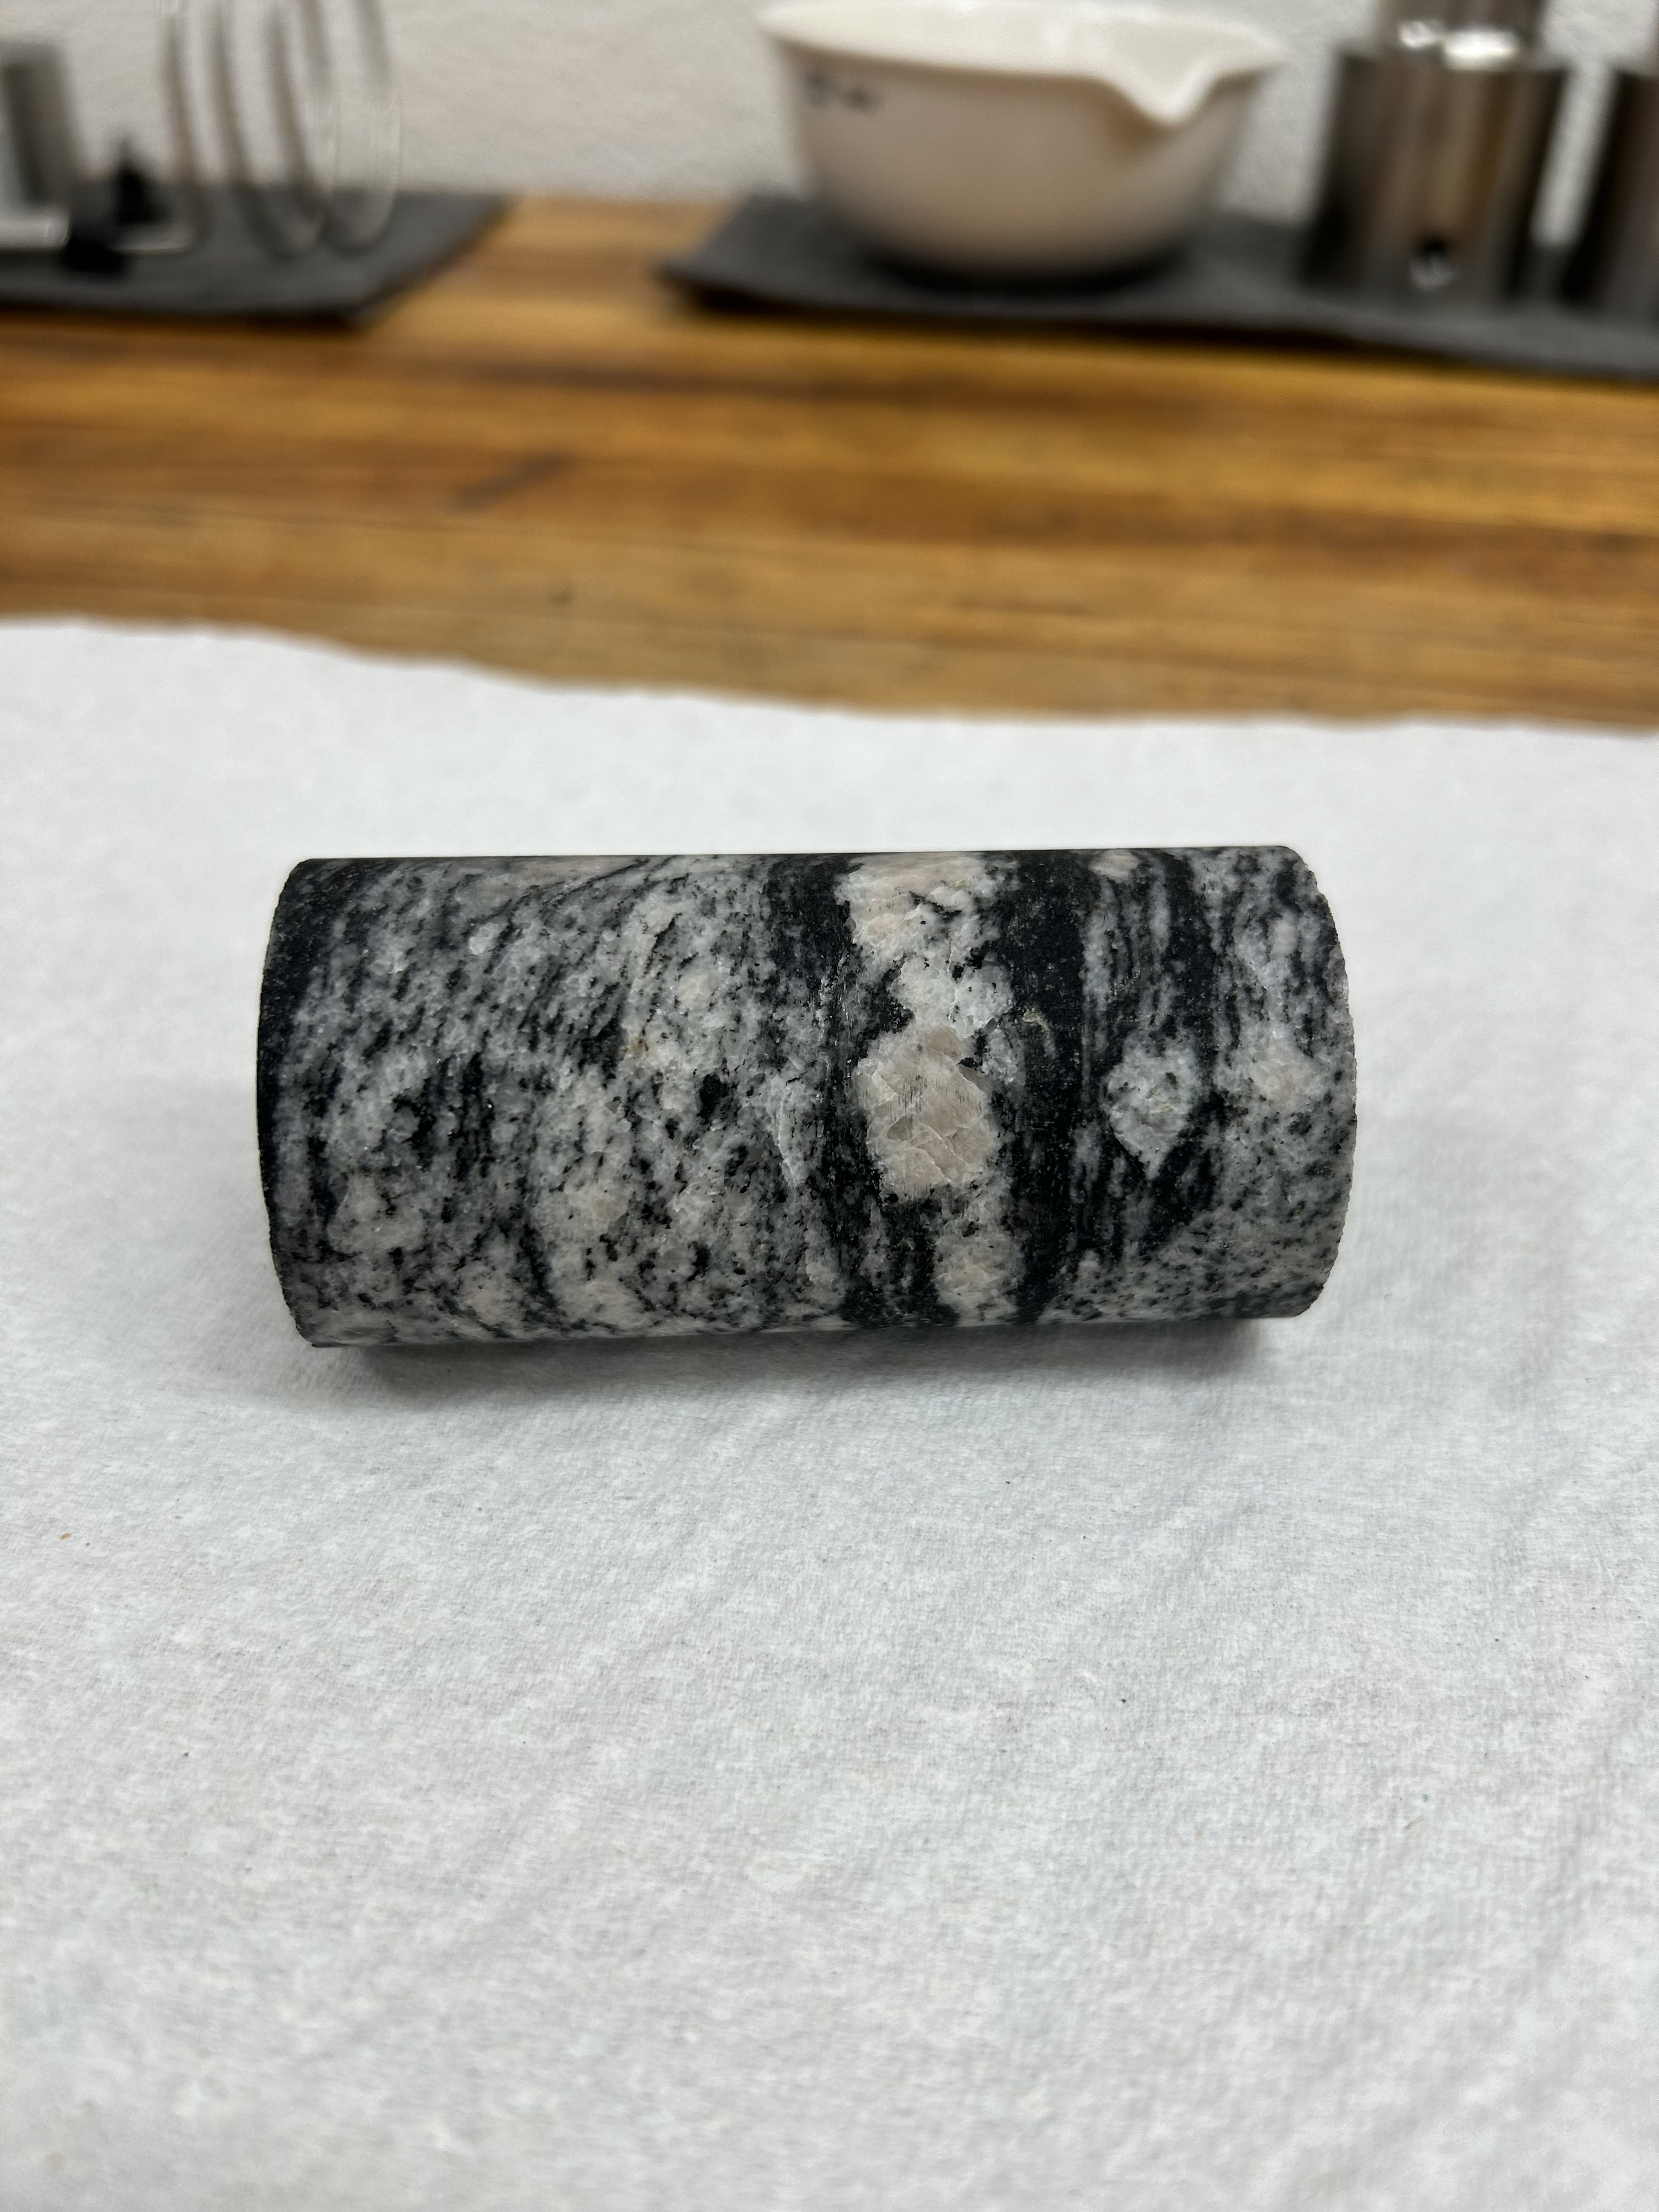
FORGE Sample
Cp = 10-70 Mpa
Smax/Smin = 1-2

Slide 3
Ultrasonic Data

Slide 4
Velocities

Slide 5
Anisotropy

Slide 6
Anisotropy
Axial
Radial

Slide 7
Anisotropy
Axial vs Radial

Slide 8
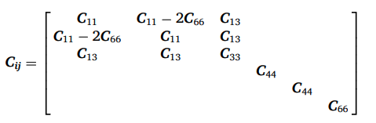
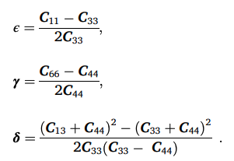
Thompson Parameters

Slide 9
Thompson Parameters

